Slide 1

Solar Energy: Powering the Future
Welcome to our presentation on solar energy! Today, we’ll explore its benefits, cutting-edge technologies, and global trends shaping a cleaner, brighter, and more sustainable future for everyone.
By Harsh Khamankar
Akshat Dubey
Pratham Ahuja
Krish Jain

Slide 2

Introduction to Solar Energy
1
Harnessing the Sun's Power
2
Clean and Sustainable
3
Growing Market
Solar energy uses sunlight, an unlimited resource, to produce electricity through photovoltaic cells or by capturing heat with solar thermal technology.
Solar energy is a clean and sustainable source of energy, as it does not produce greenhouse gases or other pollutants during operation, making it a key player in combating climate change and promoting environmental sustainability.
The solar energy industry is experiencing rapid growth globally, driven by technological advancements, falling costs, and increasing government support, making it a promising sector for investment and innovation.

Slide 3
Advantages of Solar Power
Environmental Benefits
Economic Advantages
Energy Independence
Solar power is a clean and renewable source of energy, emitting no greenhouse gases or pollutants during operation. It helps reduce reliance on fossil fuels, mitigating climate change and promoting a sustainable future.
Solar energy offers significant economic benefits, including lower electricity costs for homeowners and businesses, creating new jobs and industries related to solar technology and installation.
Solar power empowers individuals and communities to generate their own electricity, reducing reliance on centralized power grids and increasing energy independence.

Slide 4
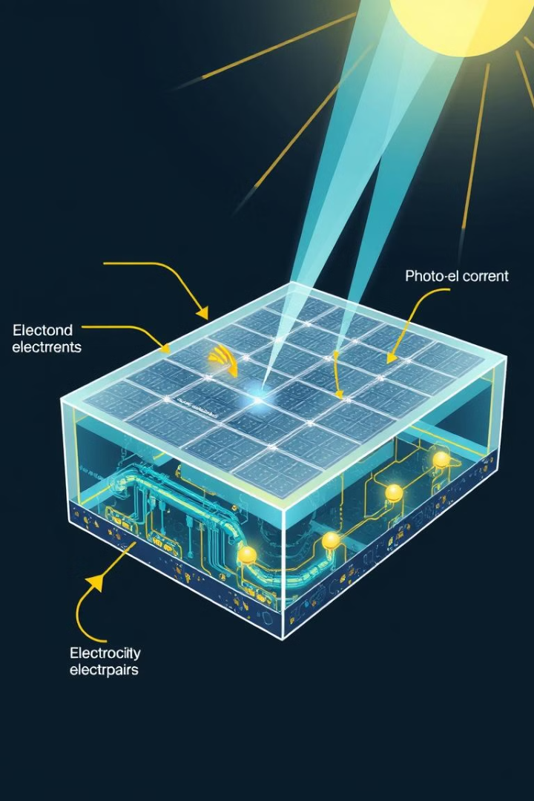


Solar Technology: Photovoltaic Cells and Solar Thermal
Photovoltaic Cells
Photovoltaic (PV) cells convert sunlight directly into electricity through the photovoltaic effect. Sunlight strikes the PV cell, causing electrons to flow, generating an electric current. PV cells are used in solar panels, which can be installed on rooftops, in solar farms, or in portable devices.
Solar Thermal
Solar thermal technology harnesses the heat of sunlight to generate hot water or electricity. Solar collectors capture sunlight and convert it into heat, which can be used to heat water for domestic use, industrial processes, or to generate electricity in a concentrated solar power plant.

Slide 5

Global Trends in Solar Energy Adoption
Technological Advancements
Falling Costs
The development of more efficient solar panels, improved energy storage solutions, and innovative solar integration techniques have propelled solar energy adoption and enhanced its competitiveness with traditional energy sources.
The cost of solar technology has been declining steadily over the past decade, making it increasingly accessible to a wider range of consumers and businesses, driving the growth of the solar energy market.
1
2
3
Government Incentives
Many governments worldwide offer incentives and subsidies to encourage the adoption of solar energy, including tax credits, rebates, and net metering programs, which further drive solar energy adoption.

Slide 6

Case Study: Renewable Energy in NEOM, Saudi Arabia
NEOM, a groundbreaking project in Saudi Arabia, serves as a shining example of ambitious renewable energy integration. The project aims to create a futuristic smart city powered by 100% renewable energy, with solar energy playing a pivotal role in this ambitious goal.

Slide 7

NEOM: A Futuristic Smart City
Sustainable Development
Technological Innovation
NEOM is designed to be a model of sustainable development, prioritizing renewable energy, green infrastructure, and eco-friendly practices. This includes using solar energy to power homes, businesses, and transportation.
The city embraces technological advancements, with a focus on artificial intelligence, robotics, and advanced data analytics, leveraging these technologies to optimize energy efficiency and create a smart city ecosystem.
Economic Diversification
NEOM aims to diversify the Saudi Arabian economy, creating new industries and opportunities in technology, renewable energy, and sustainable development, positioning the country as a global leader in these sectors.

Slide 8
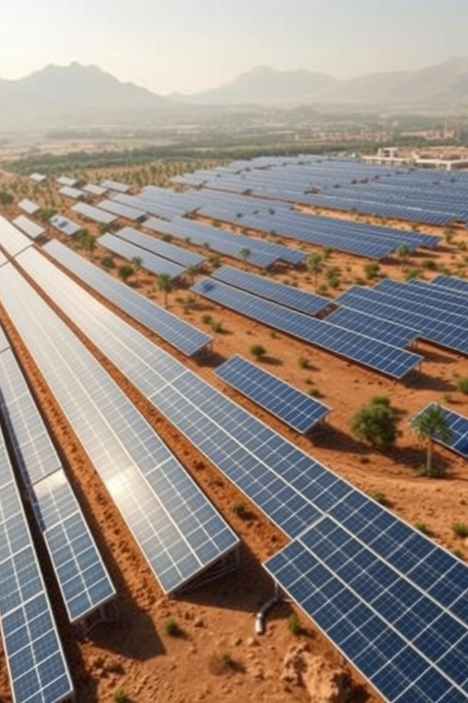



Solar Energy Integration in NEOM
Large-Scale Solar Farms
NEOM is constructing large-scale solar farms to generate a significant portion of the city's electricity needs. These farms will be equipped with advanced solar technology, maximizing efficiency and sustainability.
Rooftop Solar Installation
Solar panels are being integrated into the rooftops of buildings in NEOM, enabling residents and businesses to generate their own clean energy, reducing reliance on the grid and contributing to a greener city.
Electric Vehicle Charging
NEOM is promoting electric vehicle adoption by installing extensive networks of solar-powered charging stations, making electric transportation a sustainable and convenient option for residents.

Slide 9

Challenges and Considerations in NEOM's Solar Initiative
Challenge
Consideration
Large-scale energy storage
Developing advanced energy storage solutions to ensure reliable power supply during periods of low solar irradiance or high energy demand
Grid integration
Designing and implementing a sophisticated grid infrastructure to effectively integrate large amounts of solar energy into the existing power system
Environmental impact
Conducting thorough environmental impact assessments and implementing mitigation measures to minimize any potential negative impacts on the surrounding ecosystem

Slide 10
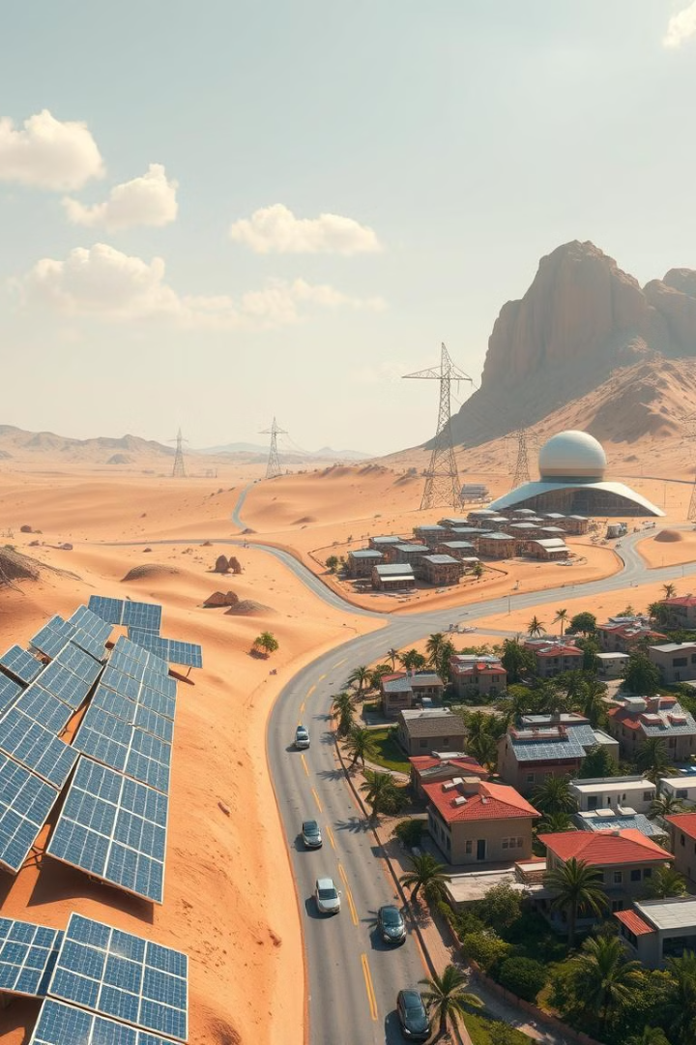
The Road Ahead: The Future of Solar Energy
As the world transitions towards a more sustainable future, solar energy is poised to play a central role. Technological advancements, falling costs, and increasing government support are driving the rapid adoption of solar energy globally. NEOM, a visionary project in Saudi Arabia, is a prime example of how solar energy can be integrated into a sustainable and innovative urban environment. As the world faces the challenges of climate change and energy security, solar energy offers a clean, reliable, and abundant source of power, paving the way for a brighter and more sustainable future.

